Slide 1
Operator Overloading
CS 201, Summer 2013

Slide 2
ADDITIONAL READING
Operator Overloading
  Chapter 8 of Pearson textbook
  http://www.learncpp.com/cpp-tutorial/91-introduction-to-operator-overloading/
  http://www.cplusplus.com/doc/tutorial/classes2/

Slide 3
Operator Overloading
Operator Overloading would be used within a class, to specify how your custom object handles math (+, -, *, /), streaming (<<, >>), subscripts( [ ] ) and other things.

Slide 4
Operator Overloading
Why overload these operators?
  Writing a custom class and adding the functionality.
  Example: A fraction class with a numerator/denominator
    Would implement addition, subtraction, multiplication, and division
  Example: Your own list class
    Want to overload subscript [ ] operators to get a specific element.

Slide 5
Overloading Arithmetic
Declaration
In MyClass.h
class MyClass
{
public:
friend MyClass operator+( const MyClass& item1, const MyClass& item2 );
friend MyClass operator-( const MyClass& item1, const MyClass& item2 );
friend MyClass operator*( const MyClass& item1, const MyClass& item2 );
friend MyClass operator/( const MyClass& item1, const MyClass& item2 );
};
Implementation
In MyClass.cpp
MyClass operator+( const MyClass& item1, const MyClass& item2 )
{
// ...
}
Notice how this function definition is not part of MyClass. It is just a normal function.

Slide 6
Overloading Comparison
Declaration
In MyClass.h
class MyClass
{
public:
friend bool operator==( MyClass& item1, MyClass& item2 );
friend bool operator!=( MyClass& item1, MyClass& item2 );
friend bool operator<( MyClass& item1, MyClass& item2 );
friend bool operator>( MyClass& item1, MyClass& item2 );
friend bool operator<=( MyClass& item1, MyClass& item2 );
friend bool operator>=( MyClass& item1, MyClass& item2 );
};
Implementation
In MyClass.cpp
bool operator==( MyClass& item1, MyClass& item2 )
{
// ...
}

Slide 7
Overloading Streams
Declaration
In MyClass.h
#include <fstream>
class MyClass
{
public:
Friend ostream& operator<<( ostream& out, MyClass& item );
Friend istream& operator>>( istream& in, MyClass& item );
};
Implementation
In MyClass.cpp
ostream& operator<<( ostream& out, MyClass& item );
{
out << item.textField << endl;
return out;
}
istream& operator<<( istream& out, MyClass& item );
{
in >> item.loadedField;
}

Slide 8
Overloading Subscript
Declaration
In MyClass.h
class MyClass
{
public:
int& operator[]( const int index );
private:
int m_data[];
};
Note:
For Arithmetic, Stream, and Comparison, they did not belong to the MyClass class and were only friends of the MyClass class.
Here, the operator[ ] is part of MyClass.
Implementation
In MyClass.cpp
int& MyClass::operator[]( const int index );
{
return m_data[ index ];
}
Secondly:
The operator[ ] does not need to return an int, it will return whatever data-type you're wanting to access.

Slide 9
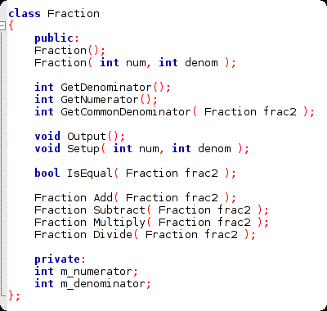
Let's Make Fractions!
We can make a fraction class that works without operator overloading.
This code is in the “Week 05” folder of the class website
https://github.com/Moosader/Problem-Solving-and-Programming-II

Slide 10
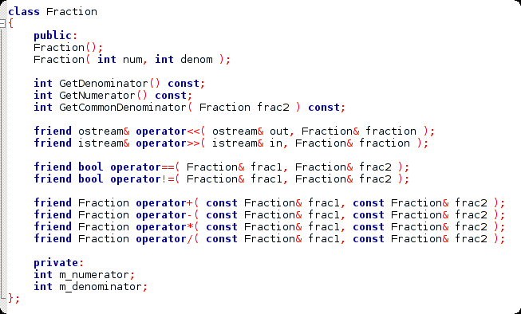
Let's Make Fractions!
Or we can utilize Operator Overloading

Slide 11
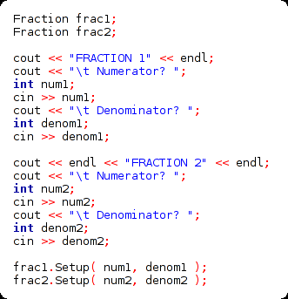
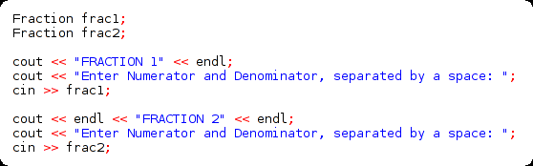
Let's Make Fractions!
Initializing the fractions
with Operator Overloading
We can overload the input stream operator so that it takes the numerator and denominator at the same time, and stores it directly in the fraction!
Initializing the fractions
without Operator Overloading

Slide 12
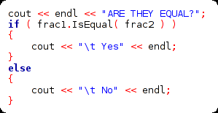
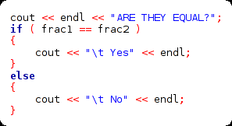
Let's Make Fractions!
Checking if equal
without Operator Overloading
Checking if equal
with Operator Overloading
Checking if the fractions are equal isn't any shorter if we overload the == operator
...But, using == is more consistent.
We compare ints and floats with ==,
so why not fractions, too?

Slide 13


Let's Make Fractions!
Arithmetic
without Operator Overloading
Arithmetic
with Operator Overloading
Doesn't it look kind of awkward to write
frac1.Add( frac2 ) ?

Slide 14
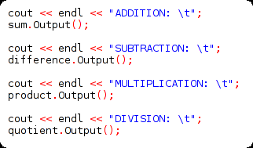
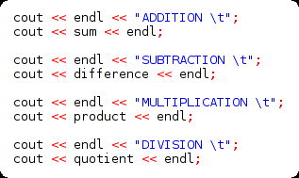
Let's Make Fractions!
Output
without Operator Overloading
Output
with Operator Overloading

